Slide 1
Data Mining Cluster Analysis: Basic Concepts and Algorithms
Lecture Notes for Chapter 8
Introduction to Data Mining
by
Tan, Steinbach, Kumar

Slide 2
What is Cluster Analysis?
Finding groups of objects such that the objects in a group will be similar (or related) to one another and different from (or unrelated to) the objects in other groups
Inter-cluster distances are maximized
Intra-cluster distances are minimized

Slide 3
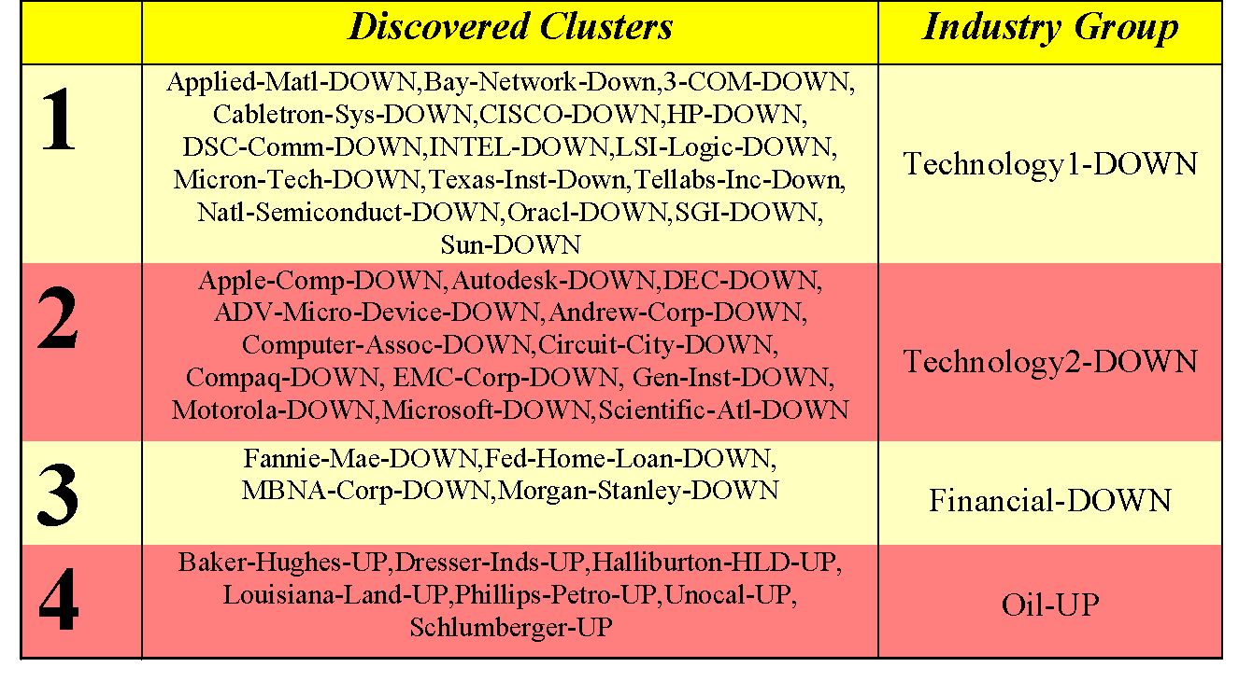
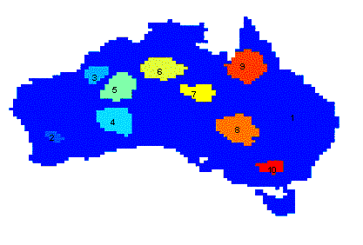
Applications of Cluster Analysis
Understanding
Group related documents for browsing, group genes and proteins that have similar functionality, or group stocks with similar price fluctuations
Summarization
Reduce the size of large data sets
Clustering precipitation in Australia

Slide 4
What is not Cluster Analysis?
Supervised classification
Have class label information
Simple segmentation
Dividing students into different registration groups alphabetically, by last name
Results of a query
Groupings are a result of an external specification
Graph partitioning
Some mutual relevance and synergy, but areas are not identical

Slide 5
Notion of a Cluster can be Ambiguous
How many clusters?
Six Clusters
Two Clusters
Four Clusters

Slide 6
Types of Clusterings
A clustering is a set of clusters
Important distinction between hierarchical and partitional sets of clusters
Partitional Clustering
A division data objects into non-overlapping subsets (clusters) such that each data object is in exactly one subset
Hierarchical clustering
A set of nested clusters organized as a hierarchical tree

Slide 7
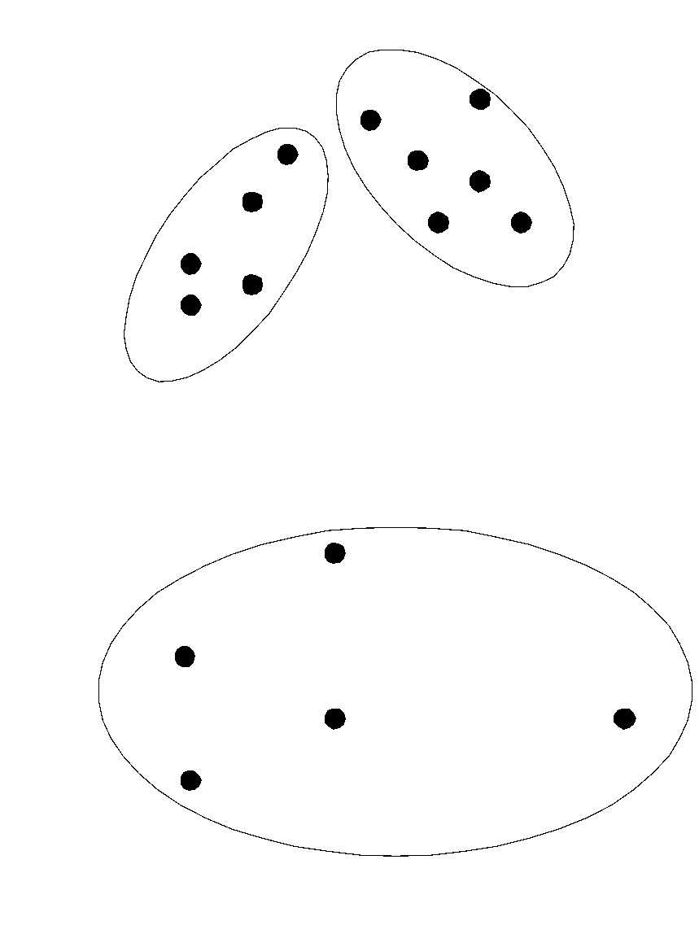
Partitional Clustering
Original Points
A Partitional Clustering

Slide 8
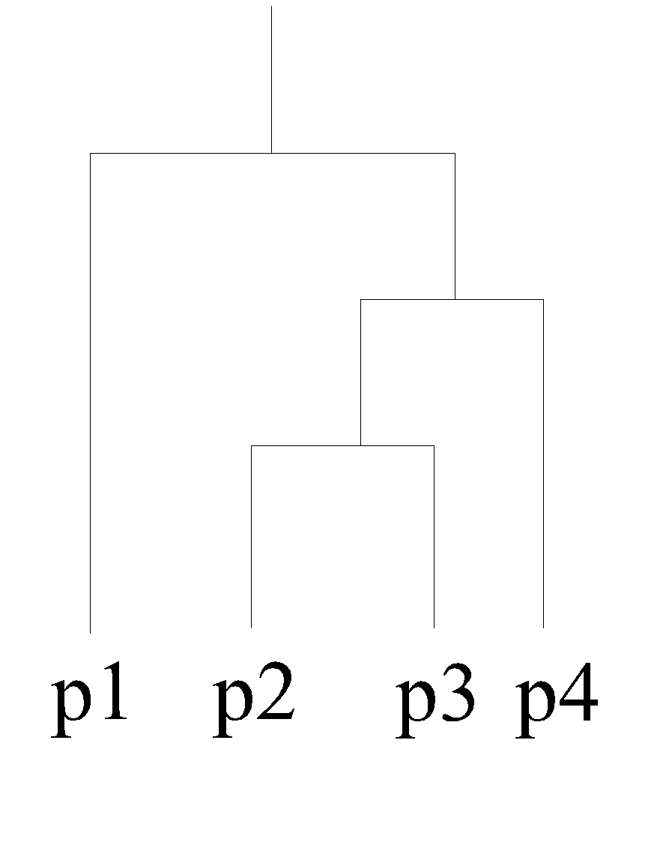
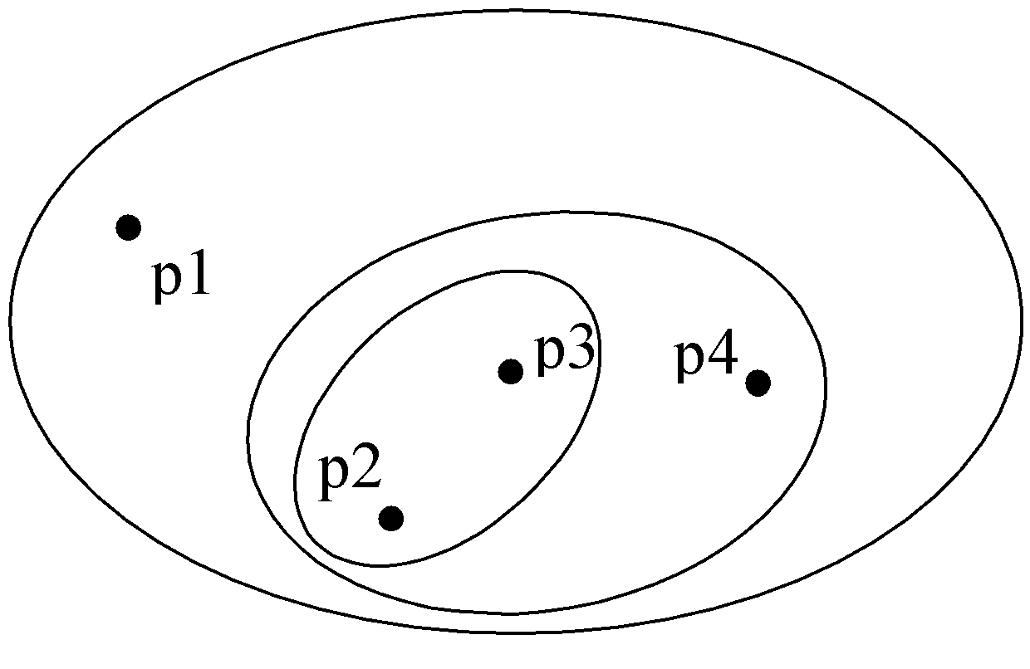
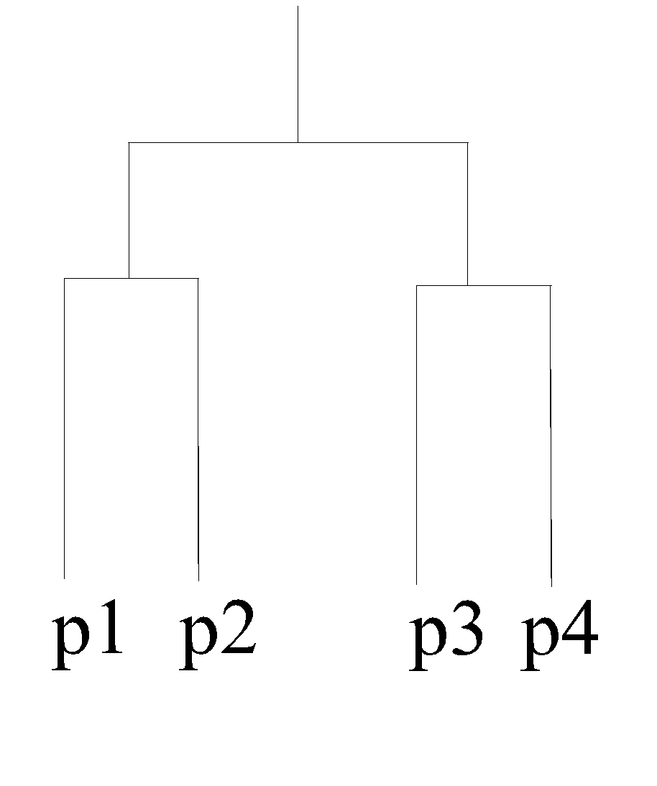
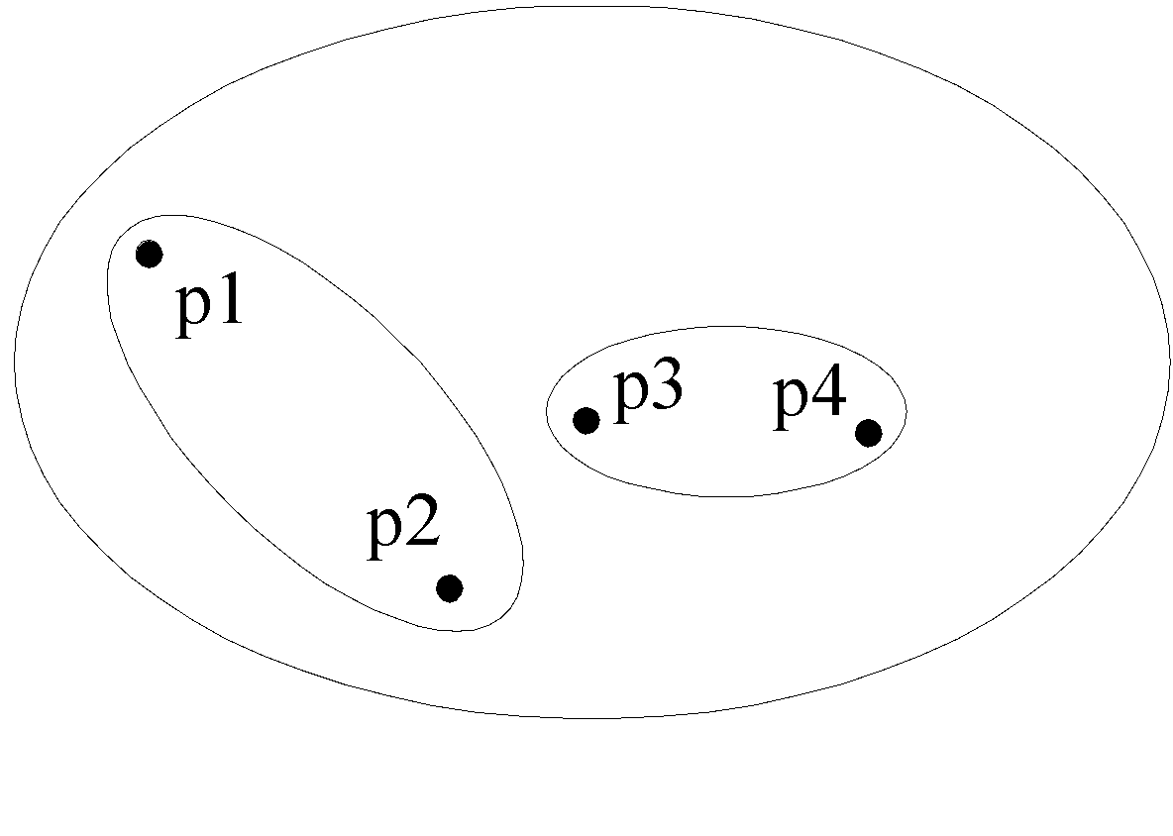
Hierarchical Clustering
Traditional Hierarchical Clustering
Traditional Dendrogram
Non-traditional Hierarchical Clustering
Non-traditional Dendrogram

Slide 9
Other Distinctions Between Sets of Clusters
Exclusive versus non-exclusive
In non-exclusive clusterings, points may belong to multiple clusters.
Can represent multiple classes or ‘border’ points
Fuzzy versus non-fuzzy
In fuzzy clustering, a point belongs to every cluster with some weight between 0 and 1
Weights must sum to 1
Probabilistic clustering has similar characteristics
Partial versus complete
In some cases, we only want to cluster some of the data
Heterogeneous versus homogeneous
Cluster of widely different sizes, shapes, and densities

Slide 10
Types of Clusters
Well-separated clusters
Center-based clusters
Contiguous clusters
Density-based clusters
Property or Conceptual
Described by an Objective Function

Slide 11
Types of Clusters: Well-Separated
Well-Separated Clusters:
A cluster is a set of points such that any point in a cluster is closer (or more similar) to every other point in the cluster than to any point not in the cluster.
3 well-separated clusters

Slide 12
Types of Clusters: Center-Based
Center-based
A cluster is a set of objects such that an object in a cluster is closer (more similar) to the “center” of a cluster, than to the center of any other cluster
The center of a cluster is often a centroid, the average of all the points in the cluster, or a medoid, the most “representative” point of a cluster
4 center-based clusters

Slide 13
Types of Clusters: Contiguity-Based
Contiguous Cluster (Nearest neighbor or Transitive)
A cluster is a set of points such that a point in a cluster is closer (or more similar) to one or more other points in the cluster than to any point not in the cluster.
8 contiguous clusters

Slide 14
Types of Clusters: Density-Based
Density-based
A cluster is a dense region of points, which is separated by low-density regions, from other regions of high density.
Used when the clusters are irregular or intertwined, and when noise and outliers are present.
6 density-based clusters

Slide 15
Types of Clusters: Conceptual Clusters
Shared Property or Conceptual Clusters
Finds clusters that share some common property or represent a particular concept.
.
2 Overlapping Circles

Slide 16
Types of Clusters: Objective Function
Clusters Defined by an Objective Function
Finds clusters that minimize or maximize an objective function.
Enumerate all possible ways of dividing the points into clusters and evaluate the `goodness' of each potential set of clusters by using the given objective function. (NP Hard)
Can have global or local objectives.
Hierarchical clustering algorithms typically have local objectives
Partitional algorithms typically have global objectives
A variation of the global objective function approach is to fit the data to a parameterized model.
Parameters for the model are determined from the data.
Mixture models assume that the data is a ‘mixture' of a number of statistical distributions.

Slide 17
Types of Clusters: Objective Function …
Map the clustering problem to a different domain and solve a related problem in that domain
Proximity matrix defines a weighted graph, where the nodes are the points being clustered, and the weighted edges represent the proximities between points
Clustering is equivalent to breaking the graph into connected components, one for each cluster.
Want to minimize the edge weight between clusters and maximize the edge weight within clusters

Slide 18
Characteristics of the Input Data Are Important
Type of proximity or density measure
This is a derived measure, but central to clustering
Sparseness
Dictates type of similarity
Adds to efficiency
Attribute type
Dictates type of similarity
Type of Data
Dictates type of similarity
Other characteristics, e.g., autocorrelation
Dimensionality
Noise and Outliers
Type of Distribution

Slide 19
Clustering Algorithms
K-means and its variants
Hierarchical clustering
Density-based clustering

Slide 20
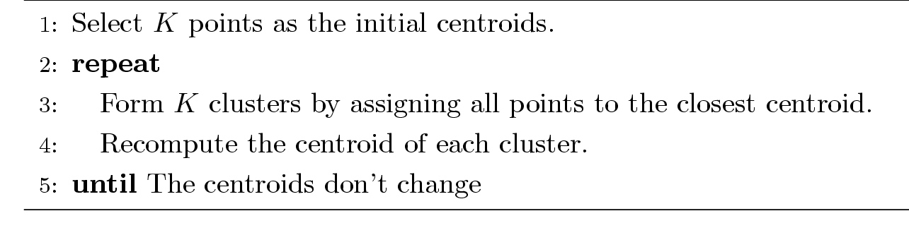
K-means Clustering
Partitional clustering approach
Each cluster is associated with a centroid (center point)
Each point is assigned to the cluster with the closest centroid
Number of clusters, K, must be specified
The basic algorithm is very simple

Slide 21
K-means Clustering – Details
Initial centroids are often chosen randomly.
Clusters produced vary from one run to another.
The centroid is (typically) the mean of the points in the cluster.
‘Closeness’ is measured by Euclidean distance, cosine similarity, correlation, etc.
K-means will converge for common similarity measures mentioned above.
Most of the convergence happens in the first few iterations.
Often the stopping condition is changed to ‘Until relatively few points change clusters’
Complexity is O( n * K * I * d )
n = number of points, K = number of clusters, I = number of iterations, d = number of attributes

Slide 22
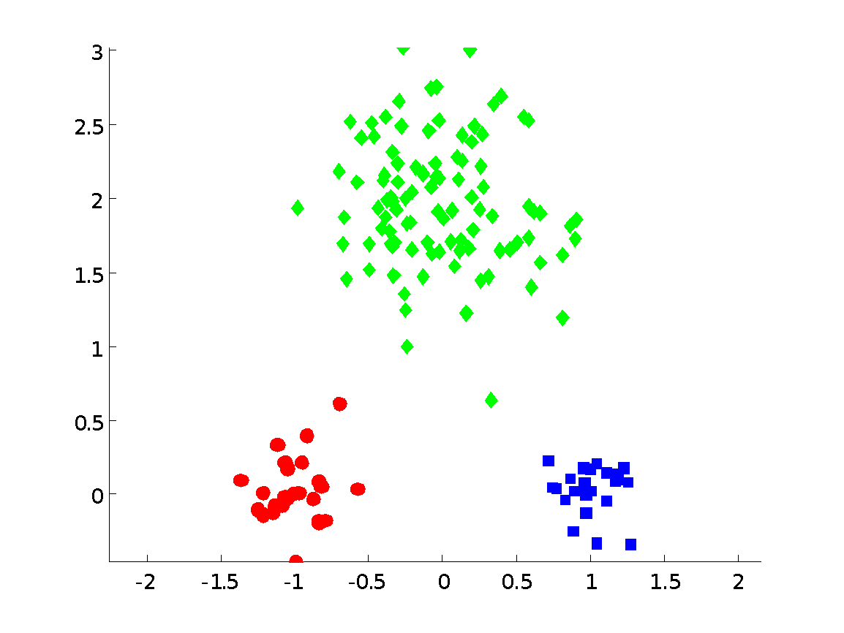
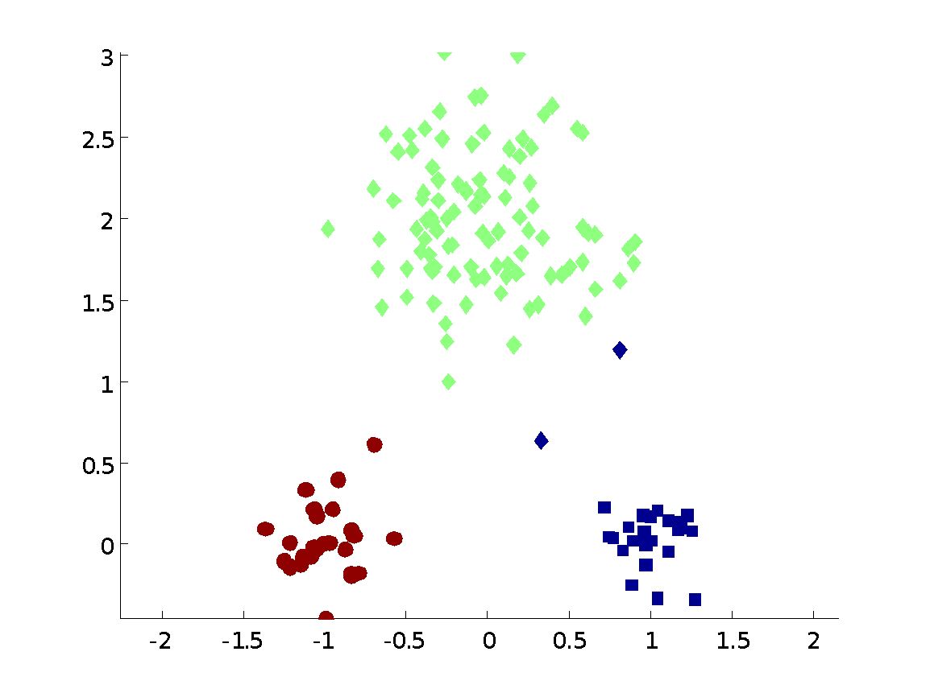
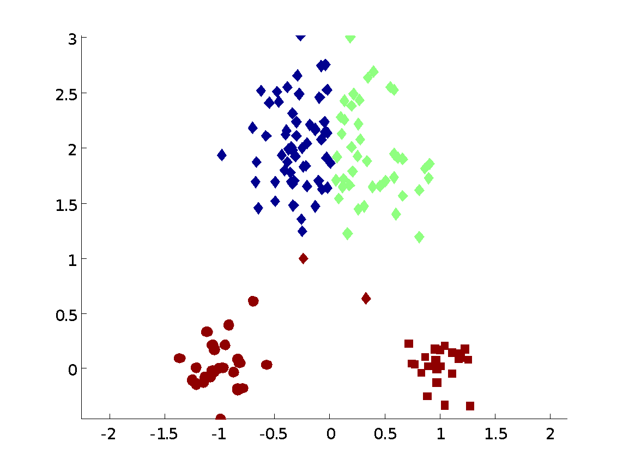
Two different K-means Clusterings
Original Points
Optimal Clustering
Sub-optimal Clustering

Slide 23
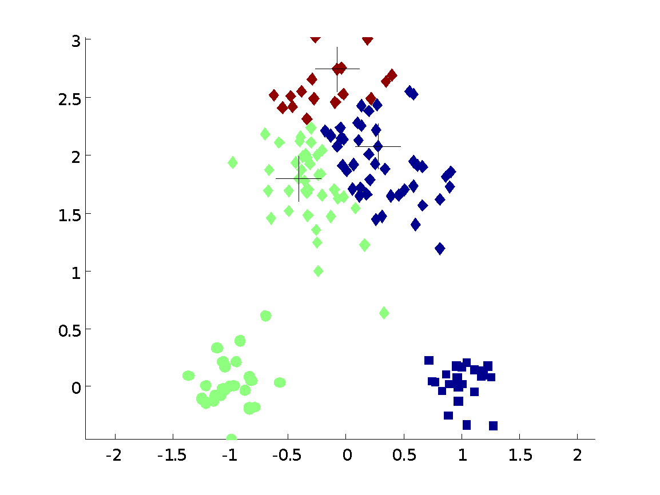
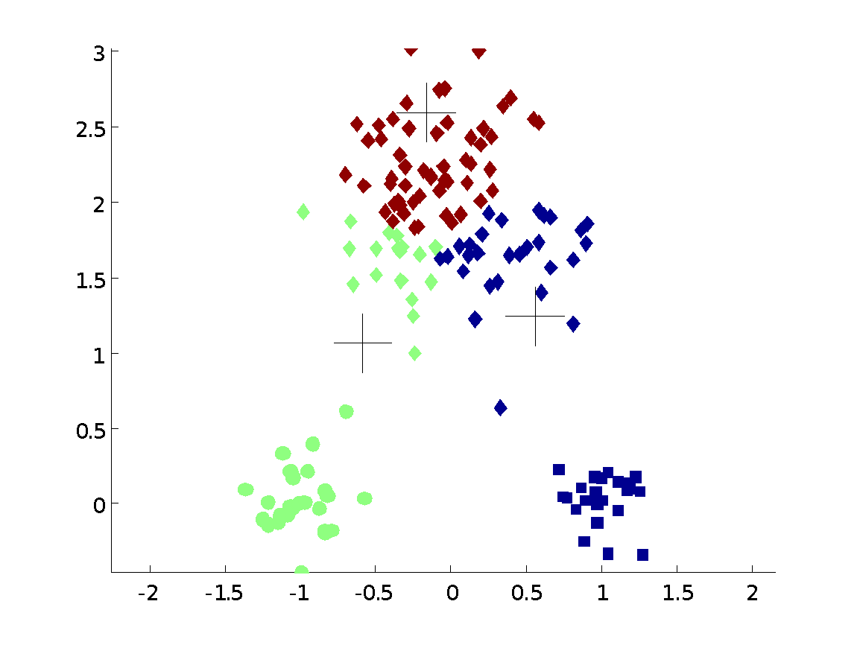
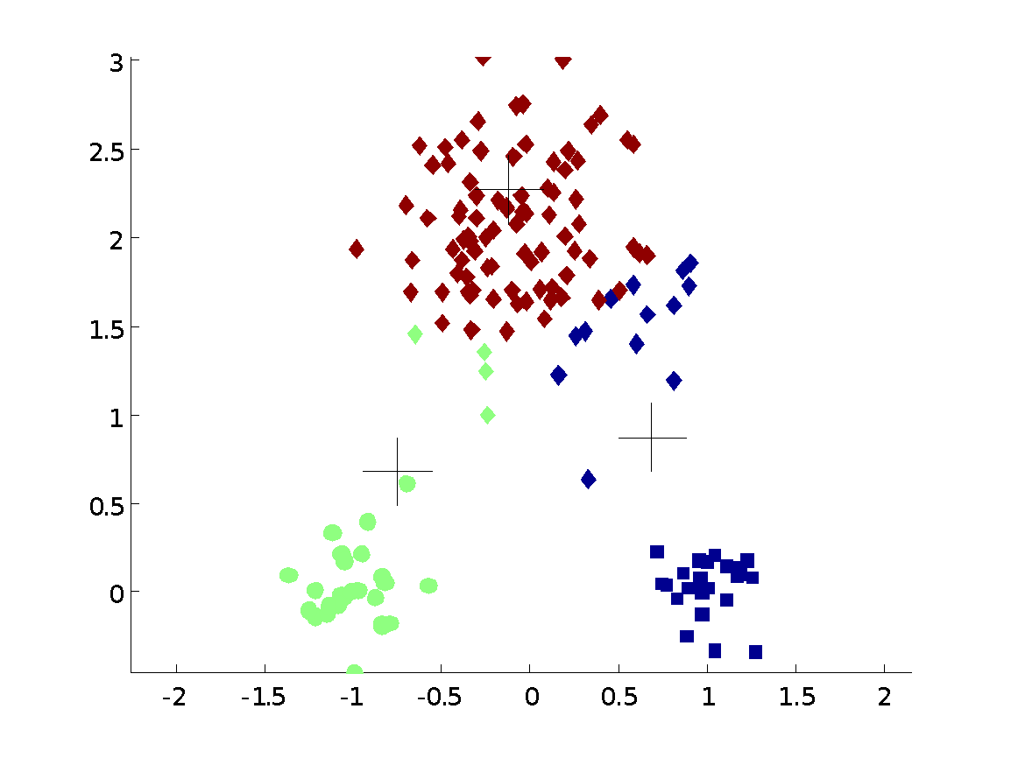
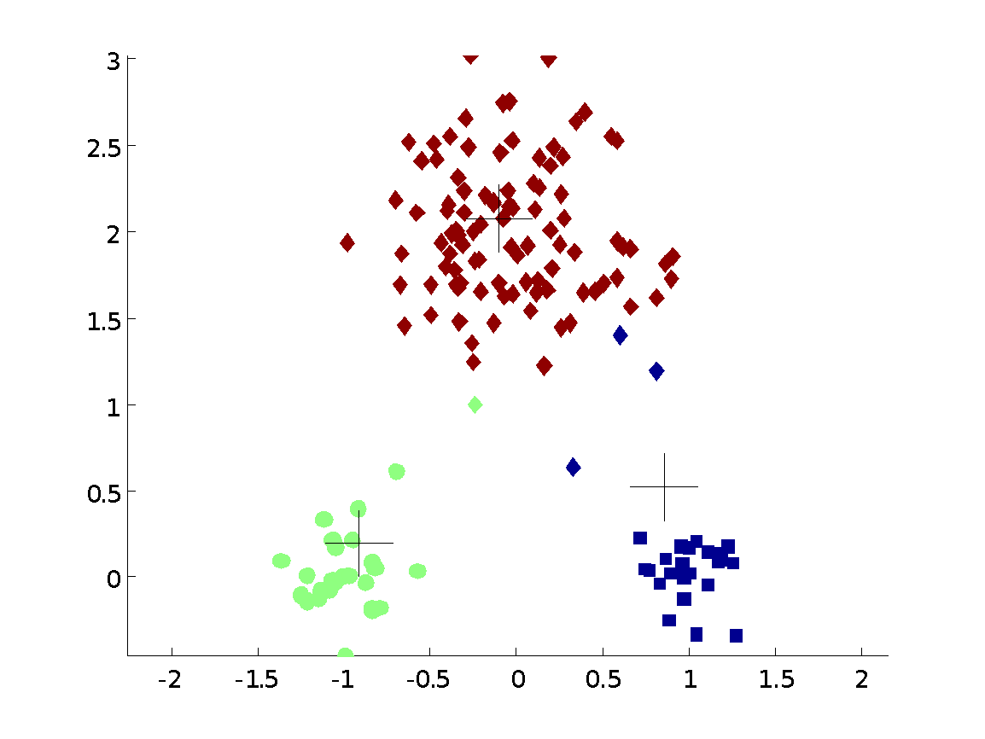


Importance of Choosing Initial Centroids

Slide 24
Importance of Choosing Initial Centroids

Slide 25
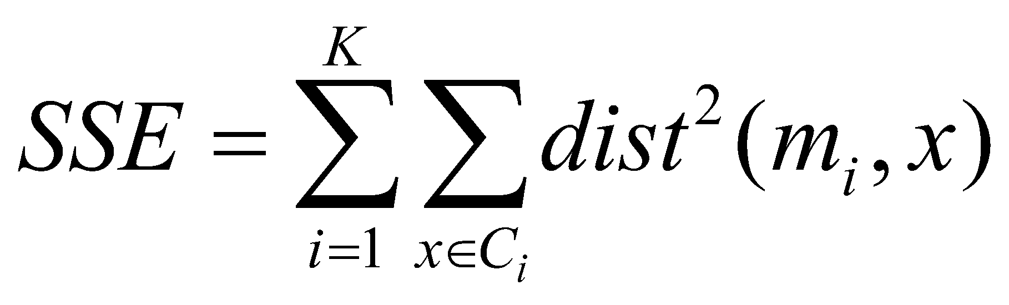
Evaluating K-means Clusters
Most common measure is Sum of Squared Error (SSE)
For each point, the error is the distance to the nearest cluster
To get SSE, we square these errors and sum them.
x is a data point in cluster C_{i} and m_{i} is the representative point for cluster C_{i}
can show that m_{i} corresponds to the center (mean) of the cluster
Given two clusters, we can choose the one with the smallest error
One easy way to reduce SSE is to increase K, the number of clusters
A good clustering with smaller K can have a lower SSE than a poor clustering with higher K

Slide 26
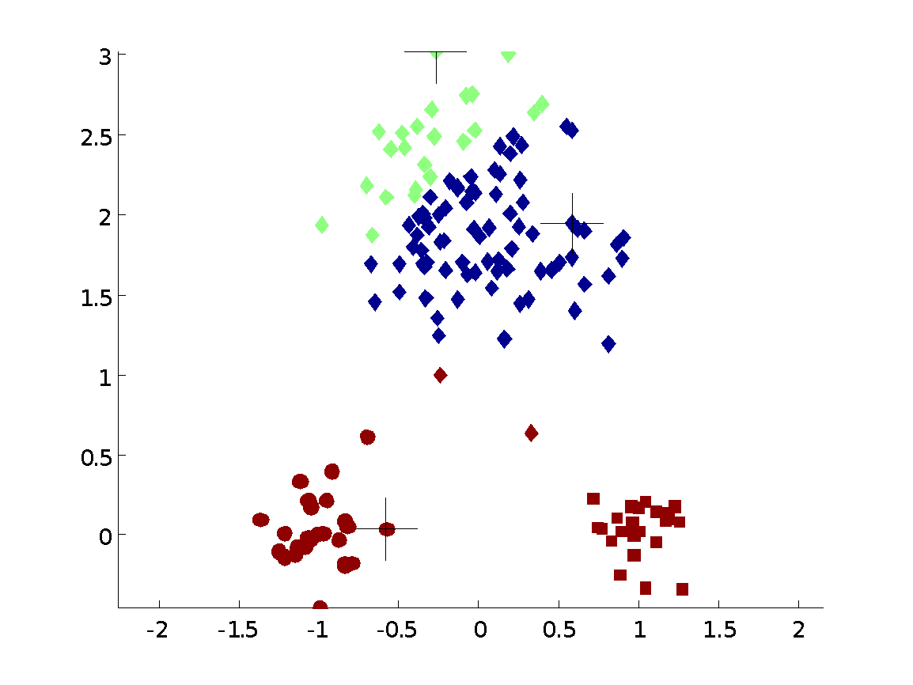
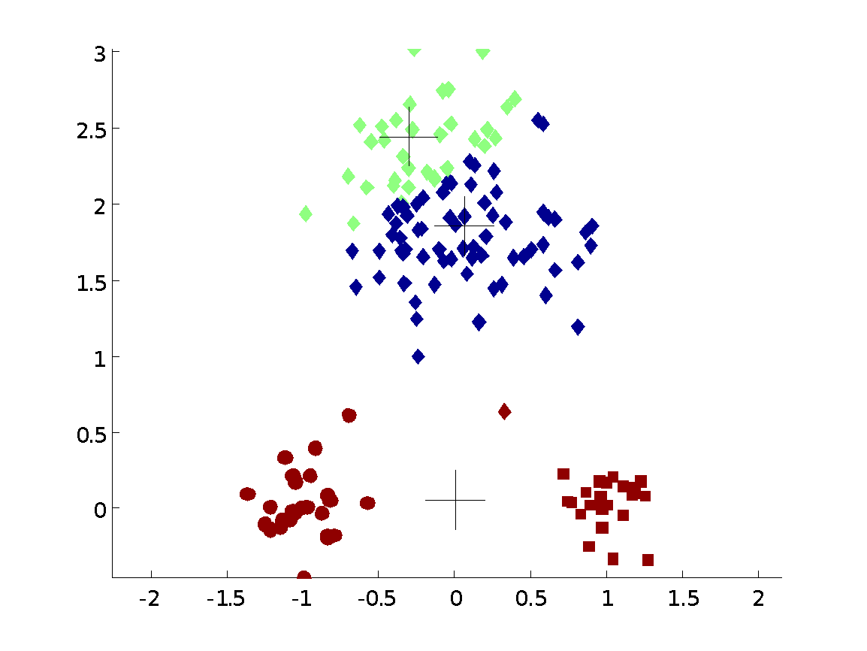
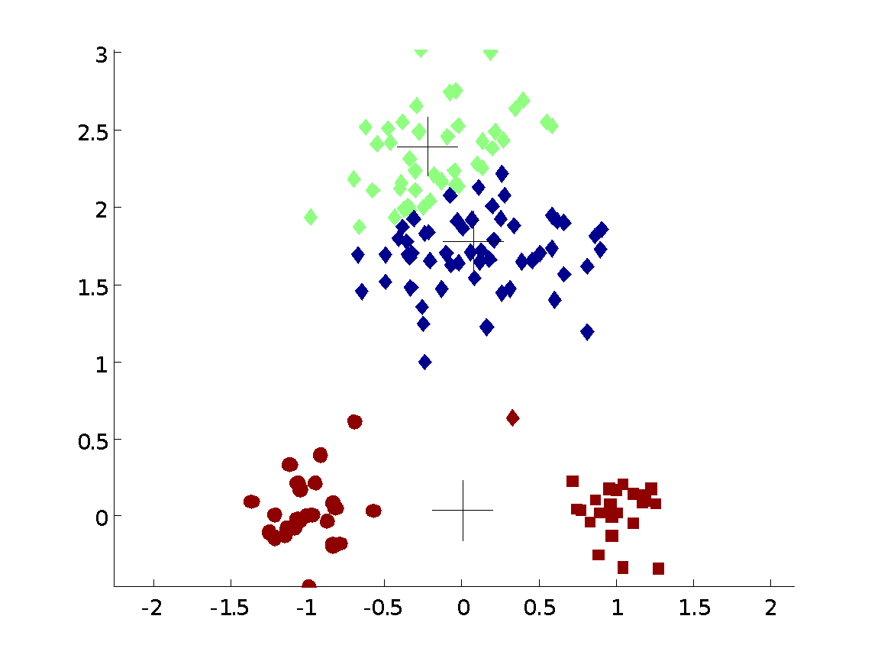
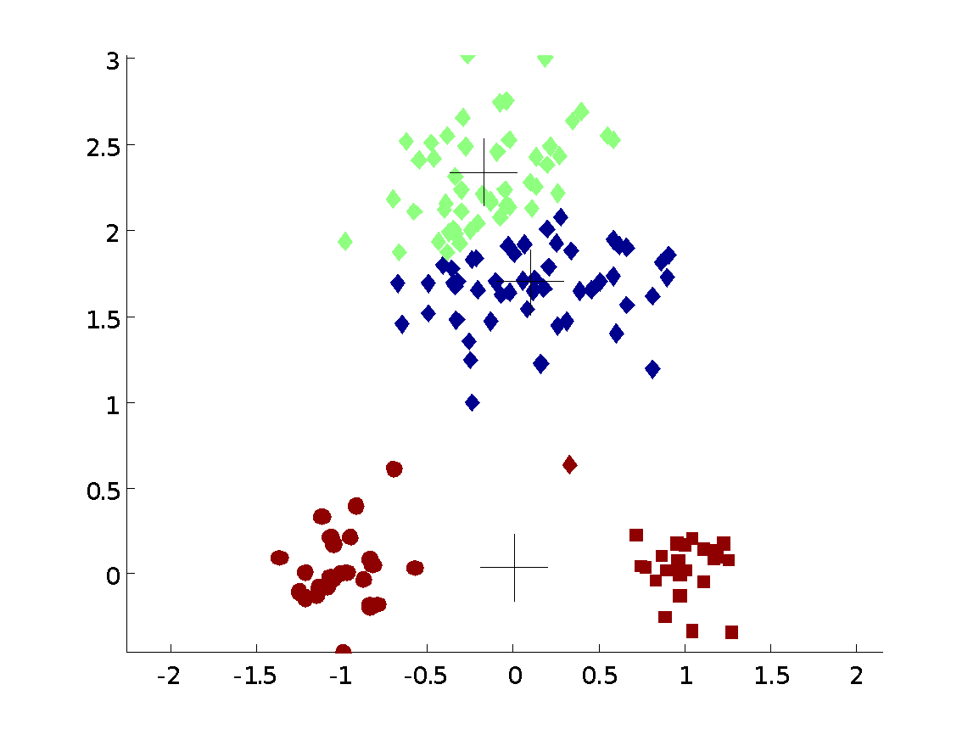

Importance of Choosing Initial Centroids …

Slide 27
Importance of Choosing Initial Centroids …

Slide 28
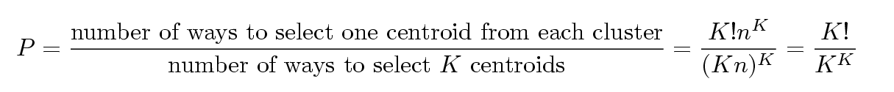
Problems with Selecting Initial Points
If there are K ‘real’ clusters then the chance of selecting one centroid from each cluster is small.
Chance is relatively small when K is large
If clusters are the same size, n, then
For example, if K = 10, then probability = 10!/10¹⁰ = 0.00036
Sometimes the initial centroids will readjust themselves in ‘right’ way, and sometimes they don’t
Consider an example of five pairs of clusters

Slide 29
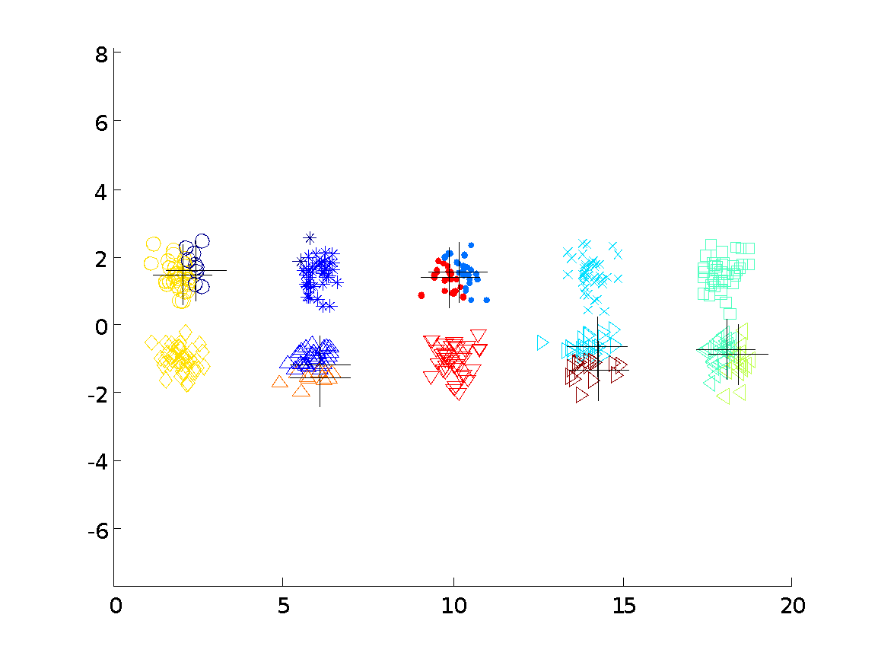
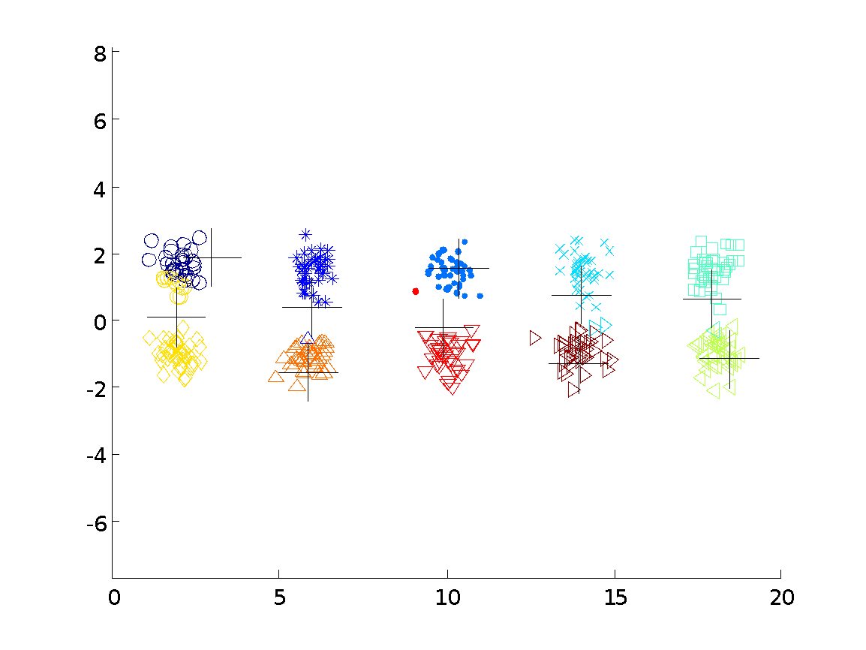
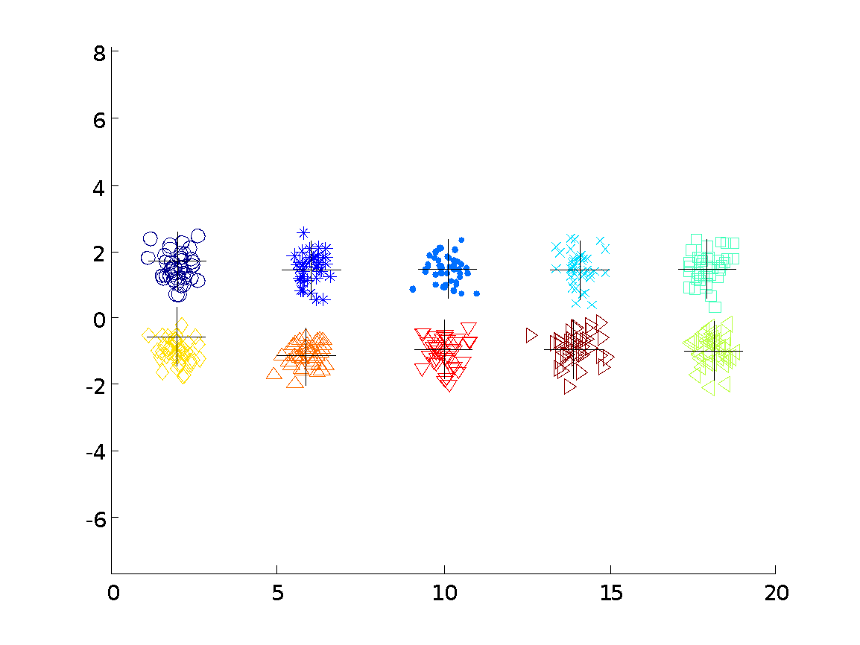

10 Clusters Example
Starting with two initial centroids in one cluster of each pair of clusters

Slide 30
10 Clusters Example
Starting with two initial centroids in one cluster of each pair of clusters

Slide 31
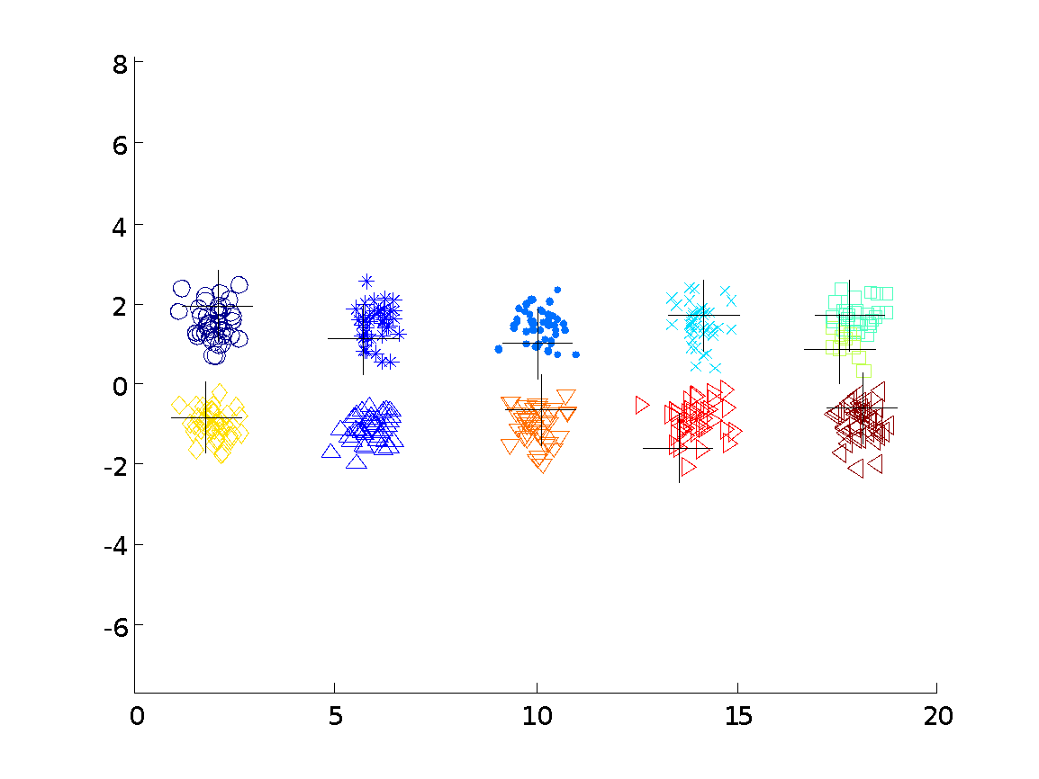



10 Clusters Example
Starting with some pairs of clusters having three initial centroids, while other have only one.

Slide 32
10 Clusters Example
Starting with some pairs of clusters having three initial centroids, while other have only one.

Slide 33
Solutions to Initial Centroids Problem
Multiple runs
Helps, but probability is not on your side
Sample and use hierarchical clustering to determine initial centroids
Select more than k initial centroids and then select among these initial centroids
Select most widely separated
Postprocessing
Bisecting K-means
Not as susceptible to initialization issues

Slide 34
Handling Empty Clusters
Basic K-means algorithm can yield empty clusters
Several strategies
Choose the point that contributes most to SSE
Choose a point from the cluster with the highest SSE
If there are several empty clusters, the above can be repeated several times.

Slide 35
Updating Centers Incrementally
In the basic K-means algorithm, centroids are updated after all points are assigned to a centroid
An alternative is to update the centroids after each assignment (incremental approach)
Each assignment updates zero or two centroids
More expensive
Introduces an order dependency
Never get an empty cluster
Can use “weights” to change the impact

Slide 36
Pre-processing and Post-processing
Pre-processing
Normalize the data
Eliminate outliers
Post-processing
Eliminate small clusters that may represent outliers
Split ‘loose’ clusters, i.e., clusters with relatively high SSE
Merge clusters that are ‘close’ and that have relatively low SSE
Can use these steps during the clustering process
ISODATA

Slide 37
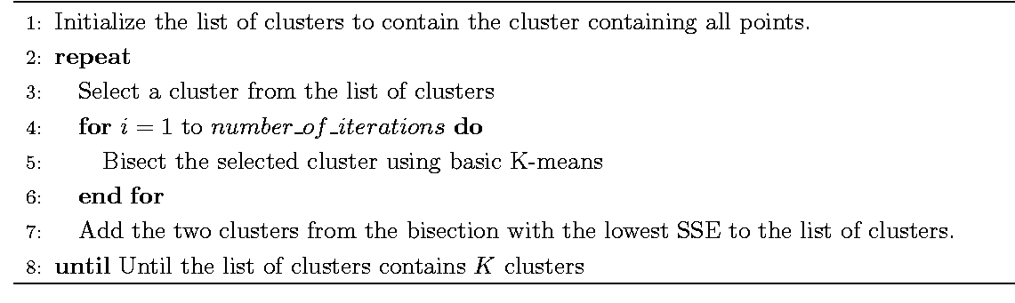
Bisecting K-means
Bisecting K-means algorithm
Variant of K-means that can produce a partitional or a hierarchical clustering

Slide 38
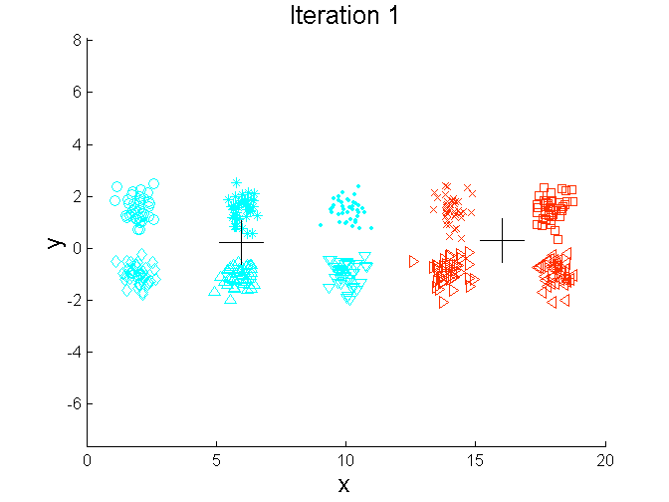
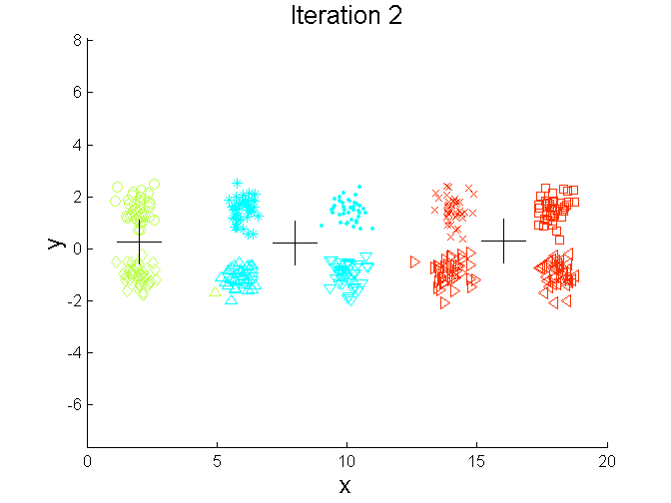
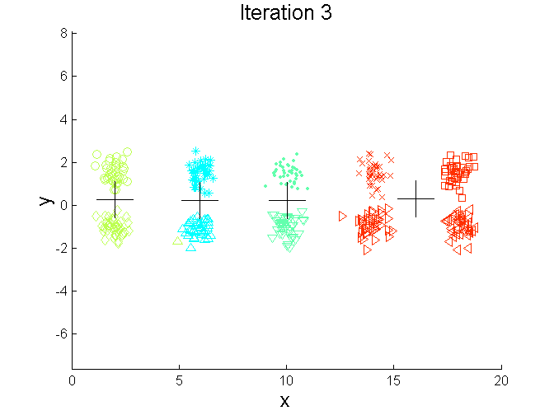
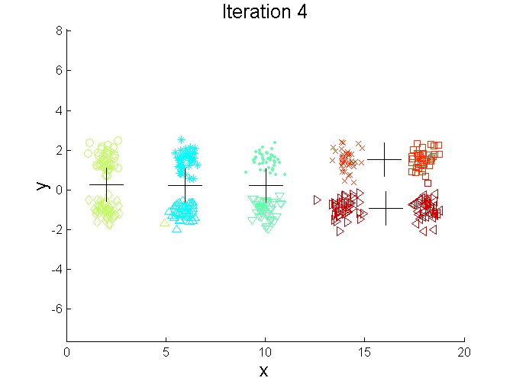
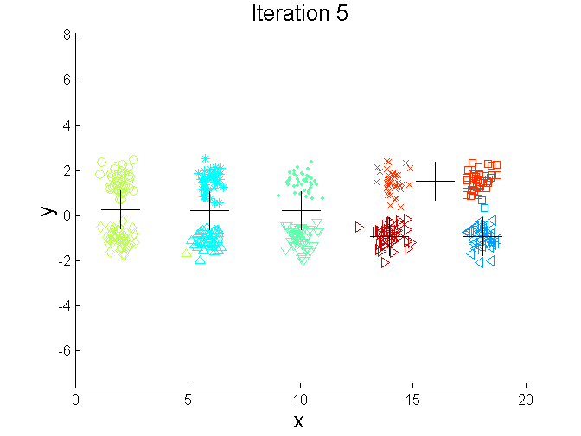
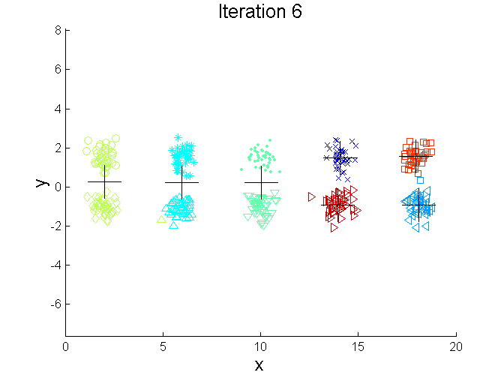
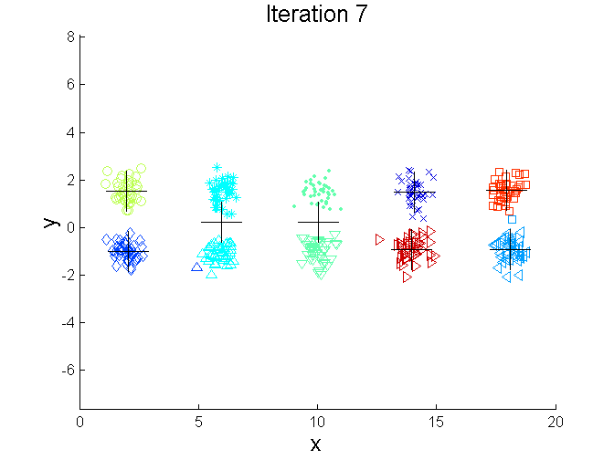
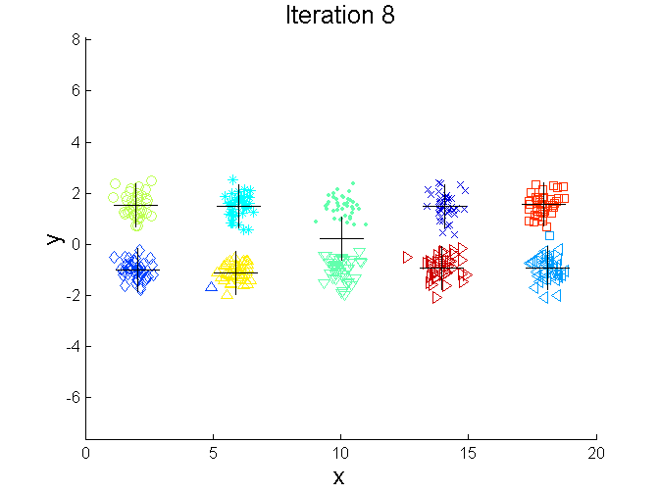
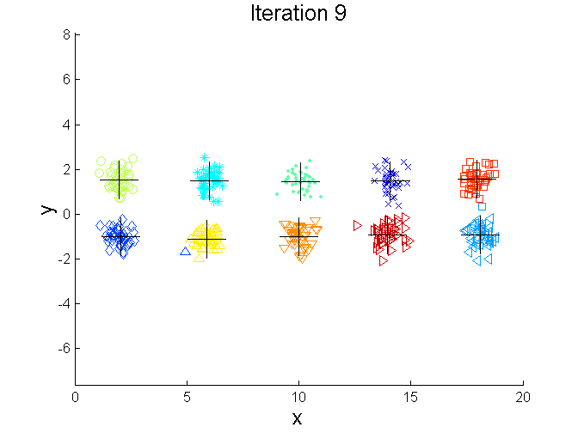
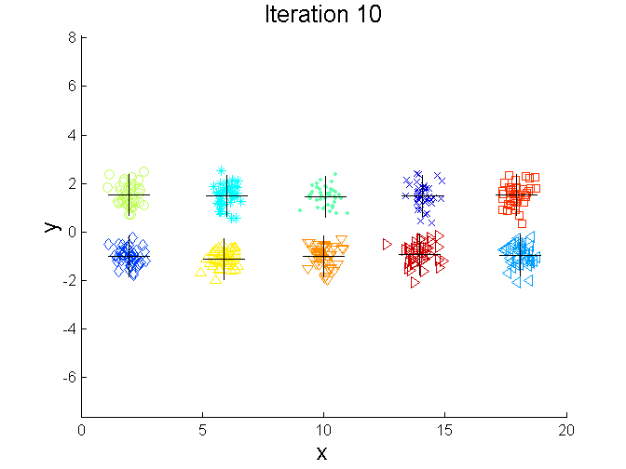
Bisecting K-means Example

Slide 39
Limitations of K-means
K-means has problems when clusters are of differing
Sizes
Densities
Non-globular shapes
K-means has problems when the data contains outliers.

Slide 40
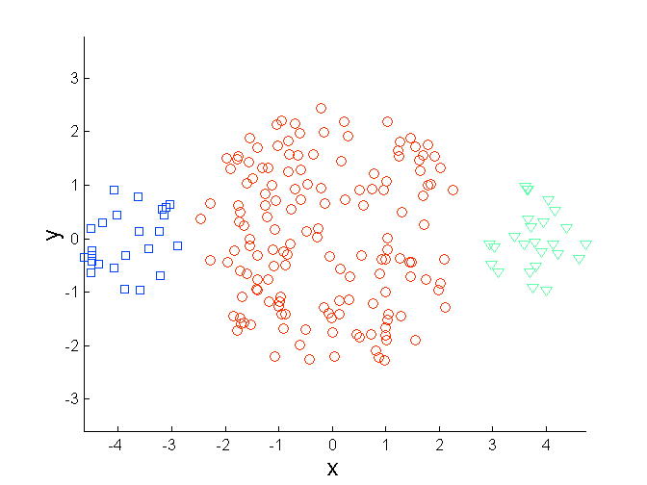
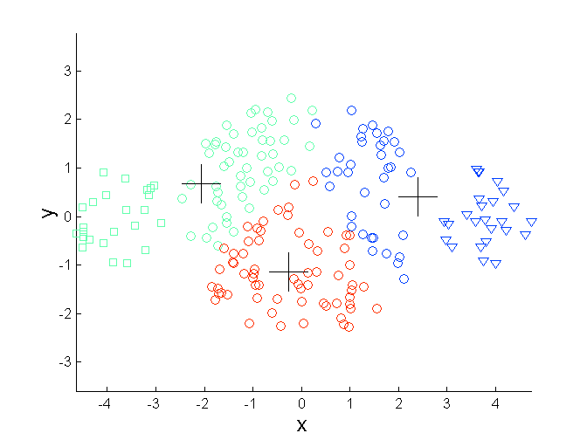
Limitations of K-means: Differing Sizes
Original Points
K-means (3 Clusters)

Slide 41
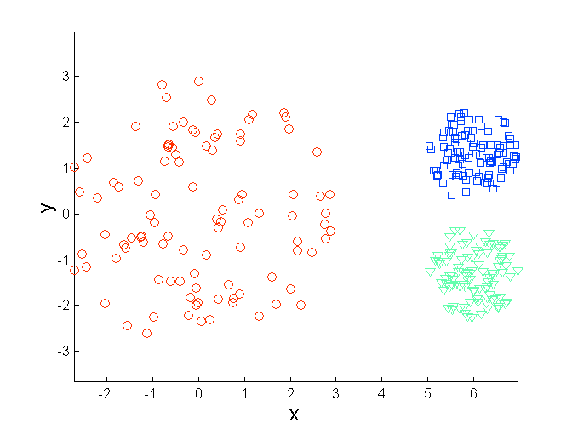
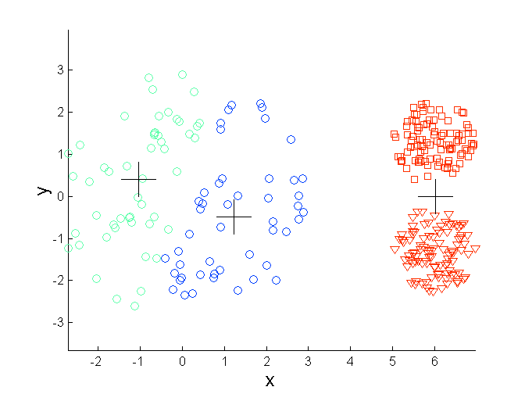
Limitations of K-means: Differing Density
Original Points
K-means (3 Clusters)

Slide 42
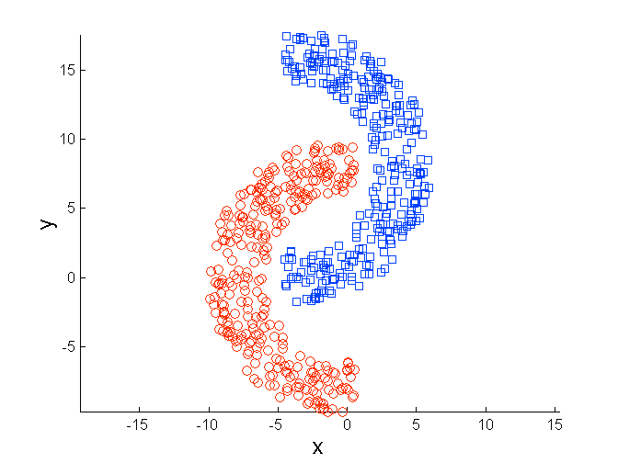
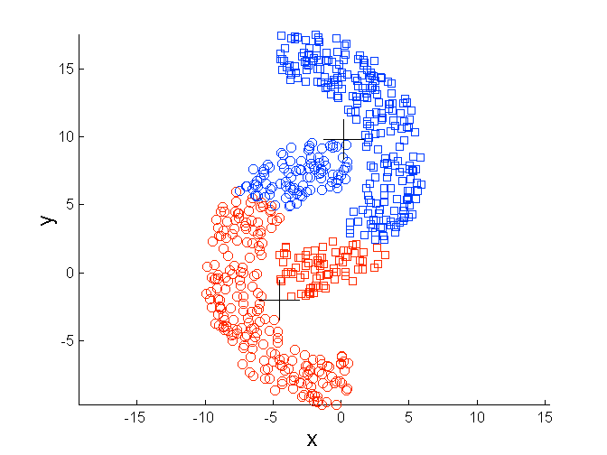
Limitations of K-means: Non-globular Shapes
Original Points
K-means (2 Clusters)

Slide 43
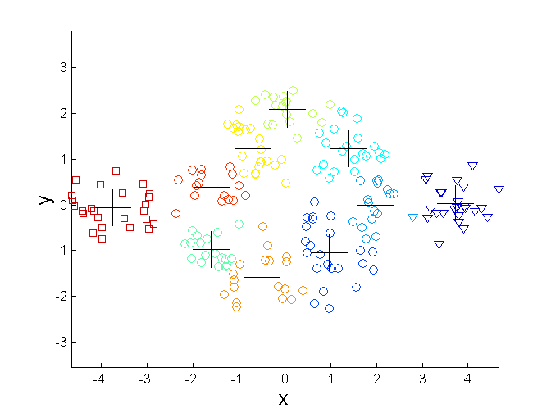
Overcoming K-means Limitations
Original Points K-means Clusters
One solution is to use many clusters.
Find parts of clusters, but need to put together.

Slide 44
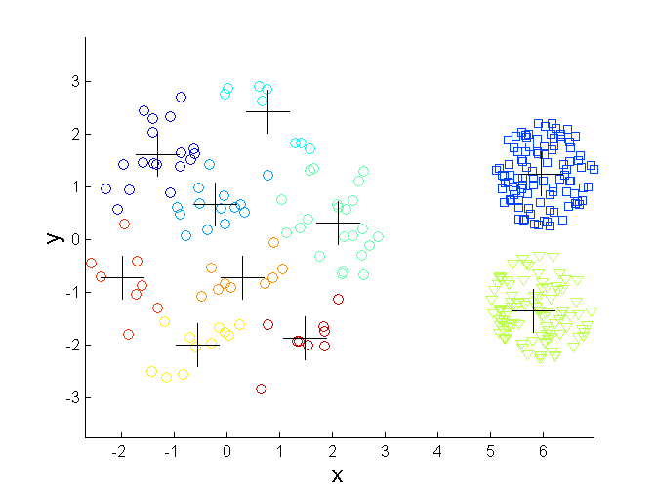
Overcoming K-means Limitations
Original Points K-means Clusters

Slide 45
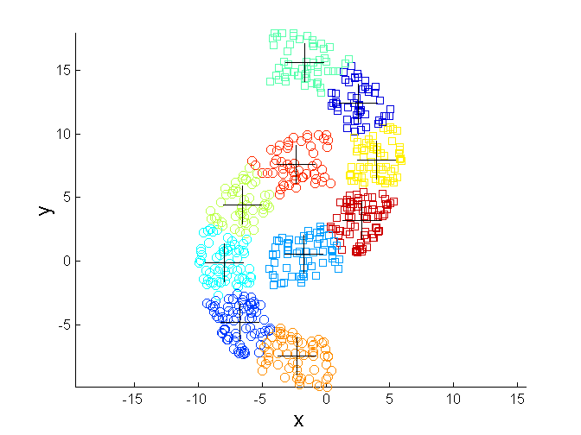
Overcoming K-means Limitations
Original Points K-means Clusters

Slide 46
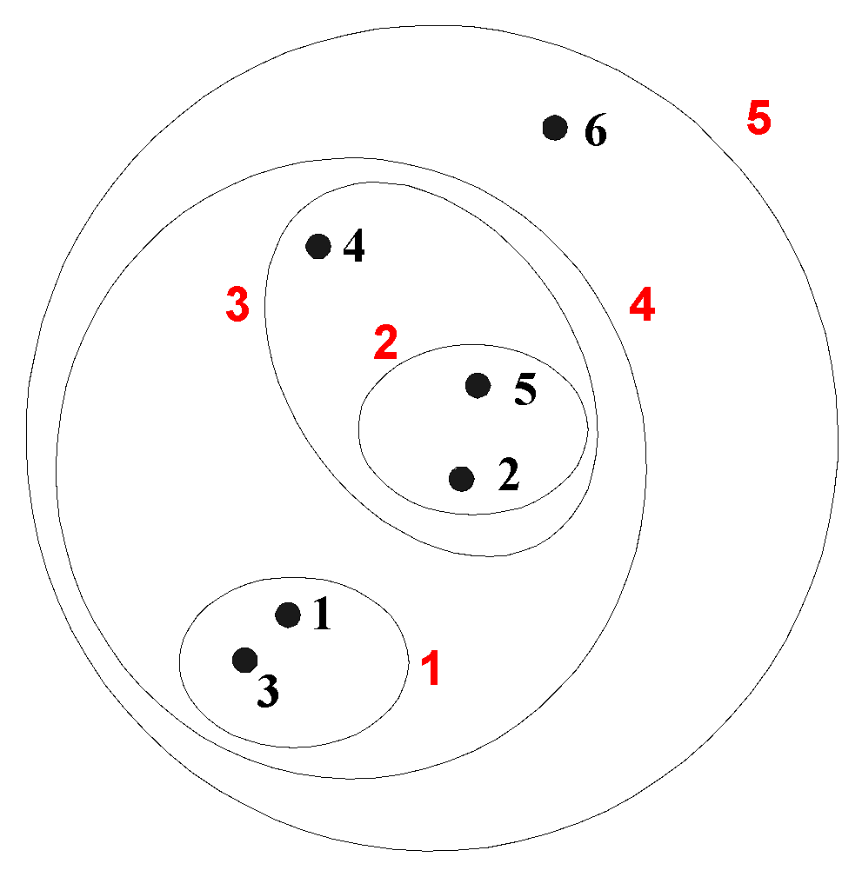
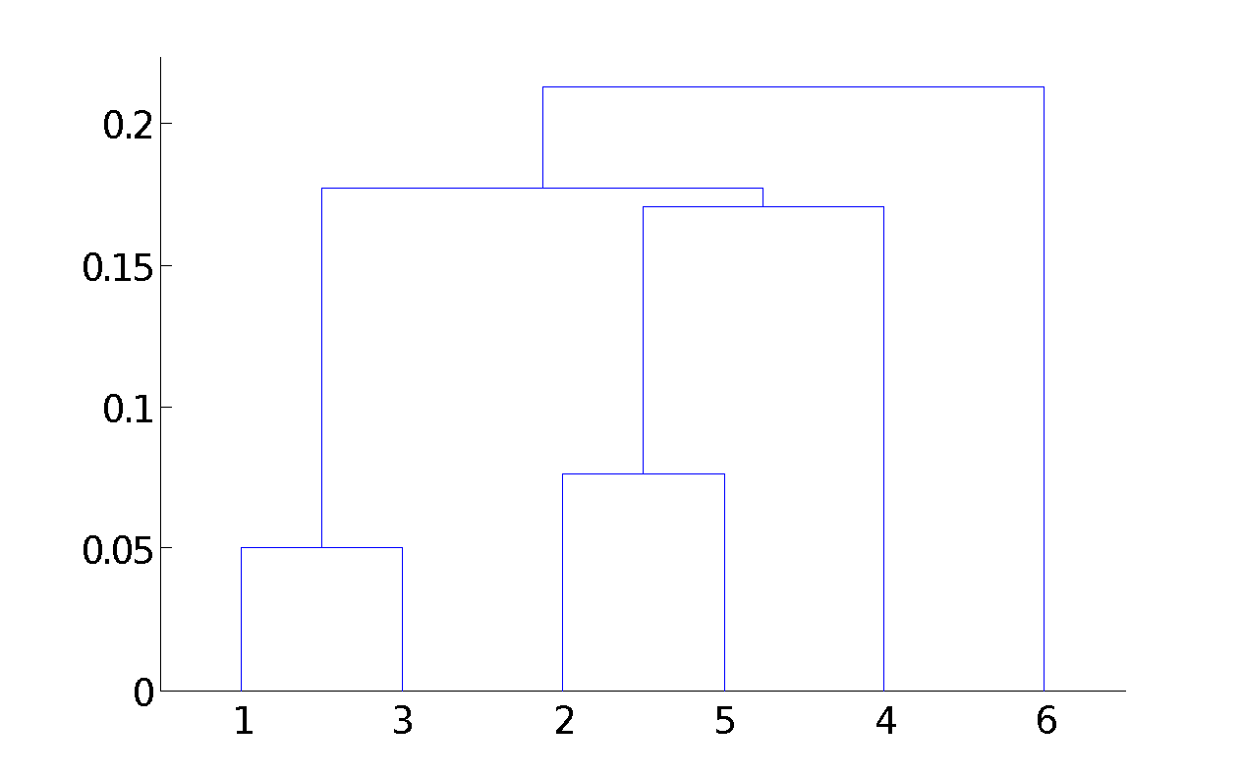
Hierarchical Clustering
Produces a set of nested clusters organized as a hierarchical tree
Can be visualized as a dendrogram
A tree like diagram that records the sequences of merges or splits

Slide 47
Strengths of Hierarchical Clustering
Do not have to assume any particular number of clusters
Any desired number of clusters can be obtained by ‘cutting’ the dendogram at the proper level
They may correspond to meaningful taxonomies
Example in biological sciences (e.g., animal kingdom, phylogeny reconstruction, …)

Slide 48
Hierarchical Clustering
Two main types of hierarchical clustering
Agglomerative:
Start with the points as individual clusters
At each step, merge the closest pair of clusters until only one cluster (or k clusters) left
Divisive:
Start with one, all-inclusive cluster
At each step, split a cluster until each cluster contains a point (or there are k clusters)
Traditional hierarchical algorithms use a similarity or distance matrix
Merge or split one cluster at a time

Slide 49
Agglomerative Clustering Algorithm
More popular hierarchical clustering technique
Basic algorithm is straightforward
Compute the proximity matrix
Let each data point be a cluster
Repeat
Merge the two closest clusters
Update the proximity matrix
Until only a single cluster remains
Key operation is the computation of the proximity of two clusters
Different approaches to defining the distance between clusters distinguish the different algorithms

Slide 50
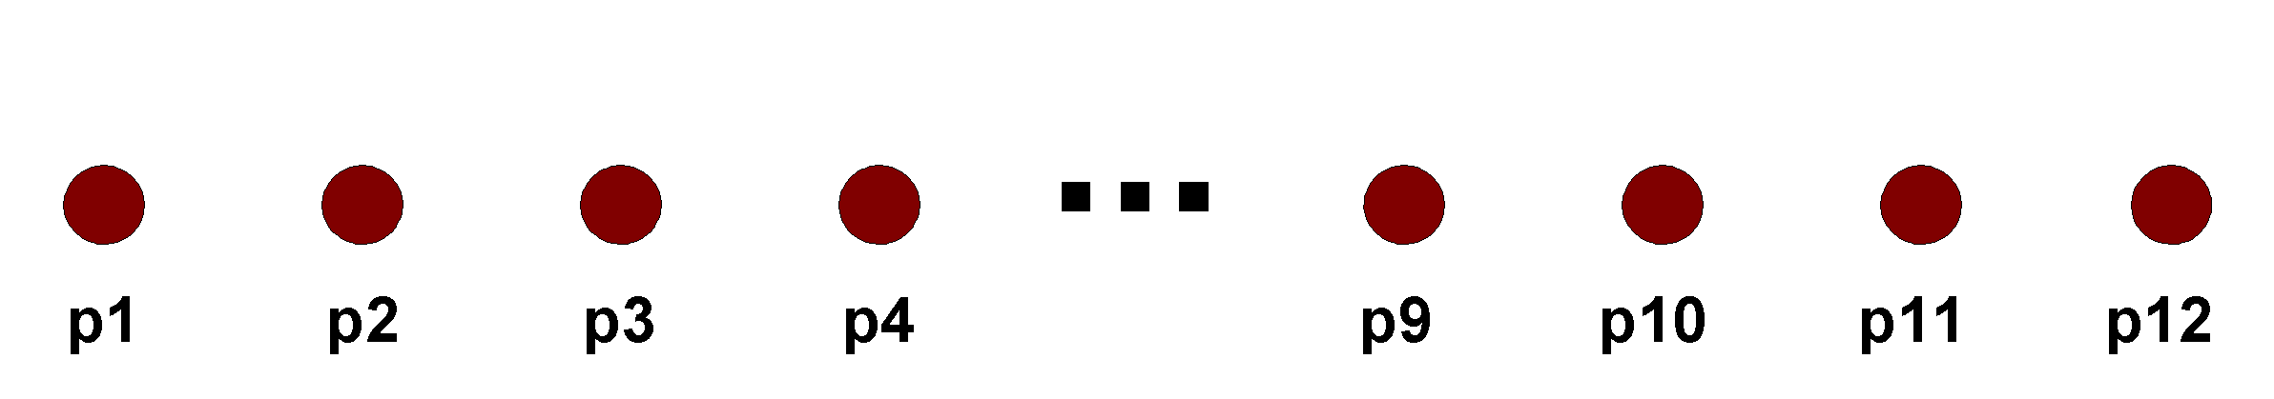
Starting Situation
Start with clusters of individual points and a proximity matrix
p1
p2
p3
p4
p5
. . .
p1
p2
p3
p4
p5
.
.
.
Proximity Matrix

Slide 51
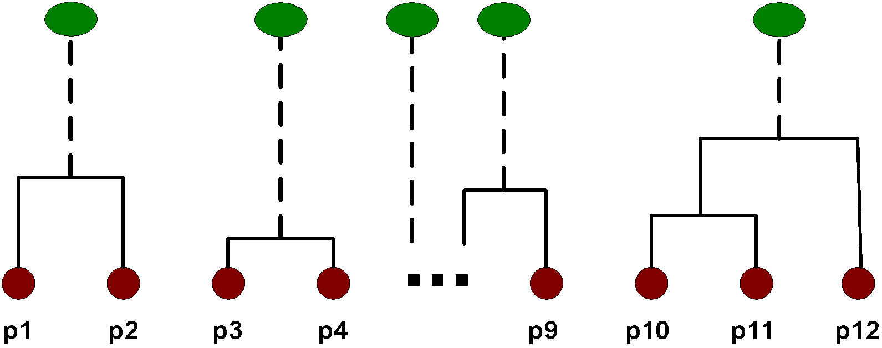
Intermediate Situation
After some merging steps, we have some clusters
C1
C2
C3
C4
C5
C1
C2
C3
C3
C4
C4
C5
Proximity Matrix
C1
C2
C5

Slide 52
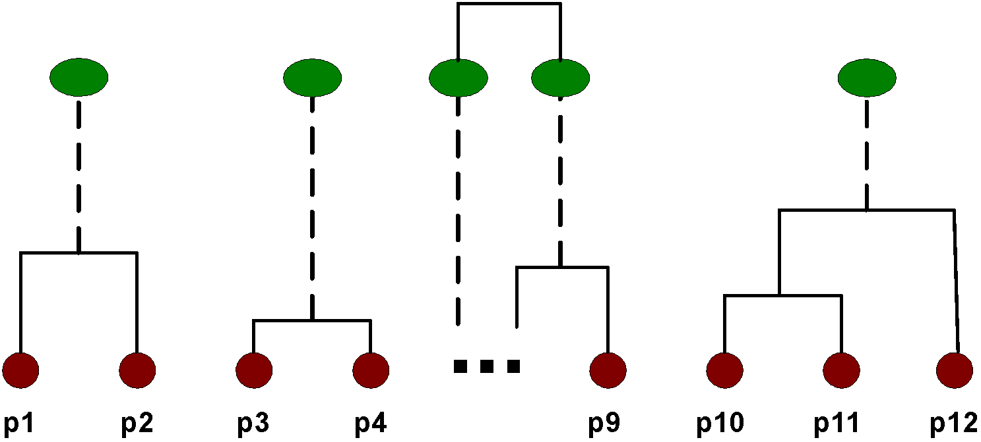
Intermediate Situation
We want to merge the two closest clusters (C2 and C5) and update the proximity matrix.
C1
C2
C3
C4
C5
C1
C2
C3
C3
C4
C4
C5
Proximity Matrix
C1
C2
C5

Slide 53

After Merging
The question is “How do we update the proximity matrix?”
C2 U C5
C1
C3
C4
C1
?
C2 U C5
? ? ? ?
C3
C3
?
C4
C4
?
Proximity Matrix
C1
C2 U C5

Slide 54
How to Define Inter-Cluster Similarity
p1
p2
p3
p4
p5
. . .
p1
Similarity?
p2
p3
p4
p5
MIN
MAX
Group Average
Distance Between Centroids
Other methods driven by an objective function
Ward’s Method uses squared error
.
.
.
Proximity Matrix

Slide 55
How to Define Inter-Cluster Similarity
p1
p2
p3
p4
p5
. . .
p1
p2
p3
p4
p5
MIN
MAX
Group Average
Distance Between Centroids
Other methods driven by an objective function
Ward’s Method uses squared error
.
.
.
Proximity Matrix

Slide 56
How to Define Inter-Cluster Similarity
p1
p2
p3
p4
p5
. . .
p1
p2
p3
p4
p5
MIN
MAX
Group Average
Distance Between Centroids
Other methods driven by an objective function
Ward’s Method uses squared error
.
.
.
Proximity Matrix

Slide 57
How to Define Inter-Cluster Similarity
p1
p2
p3
p4
p5
. . .
p1
p2
p3
p4
p5
MIN
MAX
Group Average
Distance Between Centroids
Other methods driven by an objective function
Ward’s Method uses squared error
.
.
.
Proximity Matrix

Slide 58
How to Define Inter-Cluster Similarity
p1
p2
p3
p4
p5
. . .
p1
×
×
p2
p3
p4
p5
MIN
MAX
Group Average
Distance Between Centroids
Other methods driven by an objective function
Ward’s Method uses squared error
.
.
.
Proximity Matrix

Slide 59

Cluster Similarity: MIN or Single Link
Similarity of two clusters is based on the two most similar (closest) points in the different clusters
Determined by one pair of points, i.e., by one link in the proximity graph.
1
2
3
4
5

Slide 60

Hierarchical Clustering: MIN
5
1
3
5
2
1
2
3
6
4
4
Nested Clusters
Dendrogram

Slide 61


Strength of MIN
Original Points
Two Clusters
Can handle non-elliptical shapes

Slide 62


Limitations of MIN
Original Points
Two Clusters
Sensitive to noise and outliers

Slide 63

Cluster Similarity: MAX or Complete Linkage
Similarity of two clusters is based on the two least similar (most distant) points in the different clusters
Determined by all pairs of points in the two clusters
1
2
3
4
5

Slide 64

Hierarchical Clustering: MAX
4
1
2
5
5
2
3
6
3
1
4
Nested Clusters
Dendrogram

Slide 65

Strength of MAX
Original Points
Two Clusters
Less susceptible to noise and outliers

Slide 66


Limitations of MAX
Original Points
Two Clusters
Tends to break large clusters
Biased towards globular clusters

Slide 67


Cluster Similarity: Group Average
Proximity of two clusters is the average of pairwise proximity between points in the two clusters.
Need to use average connectivity for scalability since total proximity favors large clusters
1
2
3
4
5

Slide 68

Hierarchical Clustering: Group Average
5
4
1
2
5
2
3
6
1
4
3
Nested Clusters
Dendrogram

Slide 69
Hierarchical Clustering: Group Average
Compromise between Single and Complete Link
Strengths
Less susceptible to noise and outliers
Limitations
Biased towards globular clusters

Slide 70
Cluster Similarity: Ward’s Method
Similarity of two clusters is based on the increase in squared error when two clusters are merged
Similar to group average if distance between points is distance squared
Less susceptible to noise and outliers
Biased towards globular clusters
Hierarchical analogue of K-means
Can be used to initialize K-means

Slide 71
Hierarchical Clustering: Comparison
5
1
4
1
3
2
5
5
5
2
1
MIN
2
MAX
2
3
6
3
3
6
1
4
4
4
5
5
1
4
1
2
2
5
2
Ward’s Method
5
2
3
6
Group Average
3
3
6
4
1
1
4
4
3

Slide 72
Hierarchical Clustering: Time and Space requirements
O(N²) space since it uses the proximity matrix.
N is the number of points.
O(N³) time in many cases
There are N steps and at each step the size, N², proximity matrix must be updated and searched
Complexity can be reduced to O(N² log(N) ) time for some approaches

Slide 73
Hierarchical Clustering: Problems and Limitations
Once a decision is made to combine two clusters, it cannot be undone
No objective function is directly minimized
Different schemes have problems with one or more of the following:
Sensitivity to noise and outliers
Difficulty handling different sized clusters and convex shapes
Breaking large clusters

Slide 74


MST: Divisive Hierarchical Clustering
Build MST (Minimum Spanning Tree)
Start with a tree that consists of any point
In successive steps, look for the closest pair of points (p, q) such that one point (p) is in the current tree but the other (q) is not
Add q to the tree and put an edge between p and q

Slide 75

MST: Divisive Hierarchical Clustering
Use MST for constructing hierarchy of clusters

Slide 76
DBSCAN
DBSCAN is a density-based algorithm.
Density = number of points within a specified radius (Eps)
A point is a core point if it has more than a specified number of points (MinPts) within Eps
These are points that are at the interior of a cluster
A border point has fewer than MinPts within Eps, but is in the neighborhood of a core point
A noise point is any point that is not a core point or a border point.

Slide 77

DBSCAN: Core, Border, and Noise Points

Slide 78

DBSCAN Algorithm
Eliminate noise points
Perform clustering on the remaining points

Slide 79


DBSCAN: Core, Border and Noise Points
Original Points
Point types: core, border and noise
Eps = 10, MinPts = 4

Slide 80

When DBSCAN Works Well
Original Points
Clusters
Resistant to Noise
Can handle clusters of different shapes and sizes

Slide 81



When DBSCAN Does NOT Work Well
(MinPts=4, Eps=9.75).
Original Points
Varying densities
High-dimensional data
(MinPts=4, Eps=9.92)

Slide 82

DBSCAN: Determining EPS and MinPts
Idea is that for points in a cluster, their k^{th} nearest neighbors are at roughly the same distance
Noise points have the k^{th} nearest neighbor at farther distance
So, plot sorted distance of every point to its k^{th} nearest neighbor

Slide 83
Cluster Validity
For supervised classification we have a variety of measures to evaluate how good our model is
Accuracy, precision, recall
For cluster analysis, the analogous question is how to evaluate the “goodness” of the resulting clusters?
But “clusters are in the eye of the beholder”!
Then why do we want to evaluate them?
To avoid finding patterns in noise
To compare clustering algorithms
To compare two sets of clusters
To compare two clusters

Slide 84




Clusters found in Random Data
Random Points
DBSCAN
K-means
Complete Link

Slide 85
Different Aspects of Cluster Validation
Determining the clustering tendency of a set of data, i.e., distinguishing whether non-random structure actually exists in the data.
Comparing the results of a cluster analysis to externally known results, e.g., to externally given class labels.
Evaluating how well the results of a cluster analysis fit the data without reference to external information.
- Use only the data
Comparing the results of two different sets of cluster analyses to determine which is better.
Determining the ‘correct’ number of clusters.
For 2, 3, and 4, we can further distinguish whether we want to evaluate the entire clustering or just individual clusters.

Slide 86
Measures of Cluster Validity
Numerical measures that are applied to judge various aspects of cluster validity, are classified into the following three types.
External Index: Used to measure the extent to which cluster labels match externally supplied class labels.
Entropy
Internal Index: Used to measure the goodness of a clustering structure without respect to external information.
Sum of Squared Error (SSE)
Relative Index: Used to compare two different clusterings or clusters.
Often an external or internal index is used for this function, e.g., SSE or entropy
Sometimes these are referred to as criteria instead of indices
However, sometimes criterion is the general strategy and index is the numerical measure that implements the criterion.

Slide 87
Measuring Cluster Validity Via Correlation
Two matrices
Proximity Matrix
“Incidence” Matrix
One row and one column for each data point
An entry is 1 if the associated pair of points belong to the same cluster
An entry is 0 if the associated pair of points belongs to different clusters
Compute the correlation between the two matrices
Since the matrices are symmetric, only the correlation between n(n-1) / 2 entries needs to be calculated.
High correlation indicates that points that belong to the same cluster are close to each other.
Not a good measure for some density or contiguity based clusters.

Slide 88

Measuring Cluster Validity Via Correlation
Correlation of incidence and proximity matrices for the K-means clusterings of the following two data sets.
Corr = -0.9235
Corr = -0.5810

Slide 89

Using Similarity Matrix for Cluster Validation
Order the similarity matrix with respect to cluster labels and inspect visually.

Slide 90

Using Similarity Matrix for Cluster Validation
Clusters in random data are not so crisp
DBSCAN

Slide 91

Using Similarity Matrix for Cluster Validation
Clusters in random data are not so crisp
K-means

Slide 92

Using Similarity Matrix for Cluster Validation
Clusters in random data are not so crisp
Complete Link

Slide 93


Using Similarity Matrix for Cluster Validation
DBSCAN

Slide 94


Internal Measures: SSE
Clusters in more complicated figures aren’t well separated
Internal Index: Used to measure the goodness of a clustering structure without respect to external information
SSE
SSE is good for comparing two clusterings or two clusters (average SSE).
Can also be used to estimate the number of clusters

Slide 95

Internal Measures: SSE
SSE curve for a more complicated data set
SSE of clusters found using K-means

Slide 96
Framework for Cluster Validity
Need a framework to interpret any measure.
For example, if our measure of evaluation has the value, 10, is that good, fair, or poor?
Statistics provide a framework for cluster validity
The more “atypical” a clustering result is, the more likely it represents valid structure in the data
Can compare the values of an index that result from random data or clusterings to those of a clustering result.
If the value of the index is unlikely, then the cluster results are valid
These approaches are more complicated and harder to understand.
For comparing the results of two different sets of cluster analyses, a framework is less necessary.
However, there is the question of whether the difference between two index values is significant

Slide 97


Statistical Framework for SSE
Example
Compare SSE of 0.005 against three clusters in random data
Histogram shows SSE of three clusters in 500 sets of random data points of size 100 distributed over the range 0.2 – 0.8 for x and y values

Slide 98

Statistical Framework for Correlation
Correlation of incidence and proximity matrices for the K-means clusterings of the following two data sets.
Corr = -0.9235
Corr = -0.5810

Slide 99


Internal Measures: Cohesion and Separation
Cluster Cohesion: Measures how closely related are objects in a cluster
Example: SSE
Cluster Separation: Measure how distinct or well-separated a cluster is from other clusters
Example: Squared Error
Cohesion is measured by the within cluster sum of squares (SSE)
Separation is measured by the between cluster sum of squares
Where |C_{i}| is the size of cluster i

Slide 100


Internal Measures: Cohesion and Separation
Example: SSE
BSS + WSS = constant
m
×
×
×
1
m₁
2
3
4
m₂
5
K=1 cluster:
K=2 clusters:

Slide 101
Internal Measures: Cohesion and Separation
A proximity graph based approach can also be used for cohesion and separation.
Cluster cohesion is the sum of the weight of all links within a cluster.
Cluster separation is the sum of the weights between nodes in the cluster and nodes outside the cluster.
cohesion
separation

Slide 102

Internal Measures: Silhouette Coefficient
Silhouette Coefficient combine ideas of both cohesion and separation, but for individual points, as well as clusters and clusterings
For an individual point, i
Calculate a = average distance of i to the points in its cluster
Calculate b = min (average distance of i to points in another cluster)
The silhouette coefficient for a point is then given by s = 1 – a/b if a < b, (or s = b/a - 1 if a ≥ b, not the usual case)
Typically between 0 and 1.
The closer to 1 the better.
Can calculate the Average Silhouette width for a cluster or a clustering

Slide 103

External Measures of Cluster Validity: Entropy and Purity

Slide 104
Final Comment on Cluster Validity
“The validation of clustering structures is the most difficult and frustrating part of cluster analysis.
Without a strong effort in this direction, cluster analysis will remain a black art accessible only to those true believers who have experience and great courage.”
Algorithms for Clustering Data, Jain and Dubes

